Slide 1
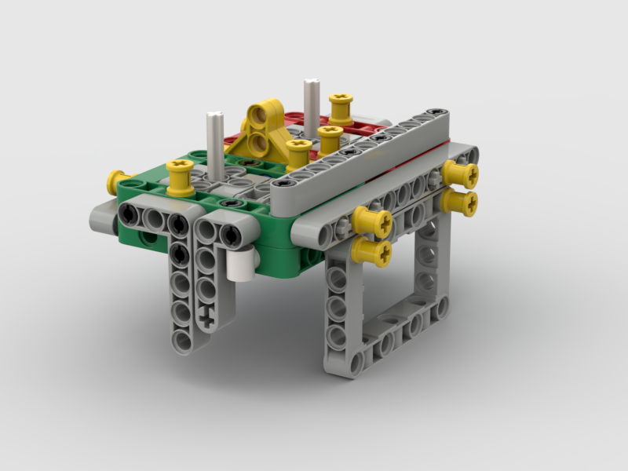
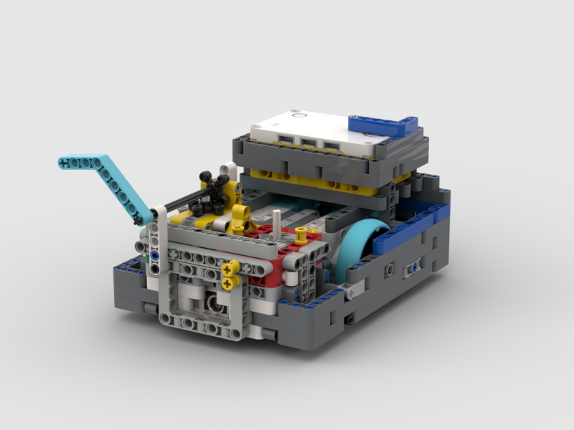
Step 2 - Right Angle Attachments Introduction
Go from this….
to this!

Slide 2
Decisions
At this point you have a Base Attachment. From here, you can build any attachment. But before we go any further, we need to make two very important decisions:
Which way do you want your final axle to point (up, left-right, or forward)?
What gear ratio do you need?

Slide 3

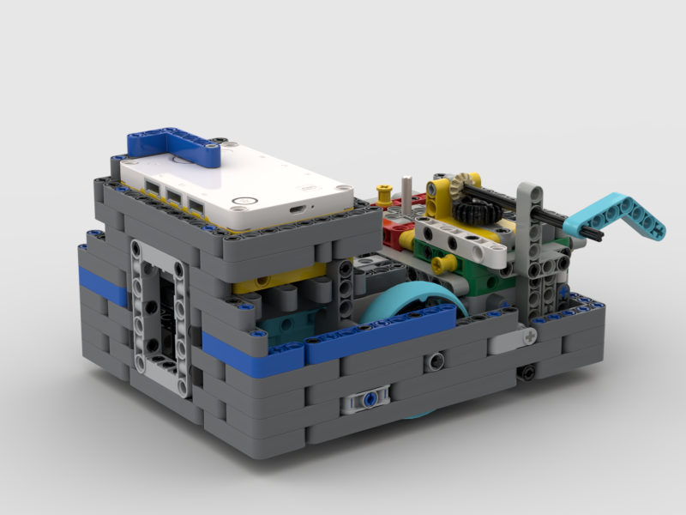
Final Axle Direction
Three choices: Up, Left-Right, or Forward
If you need an Up axle, you are basically done because the axle is already pointing upward

Slide 4
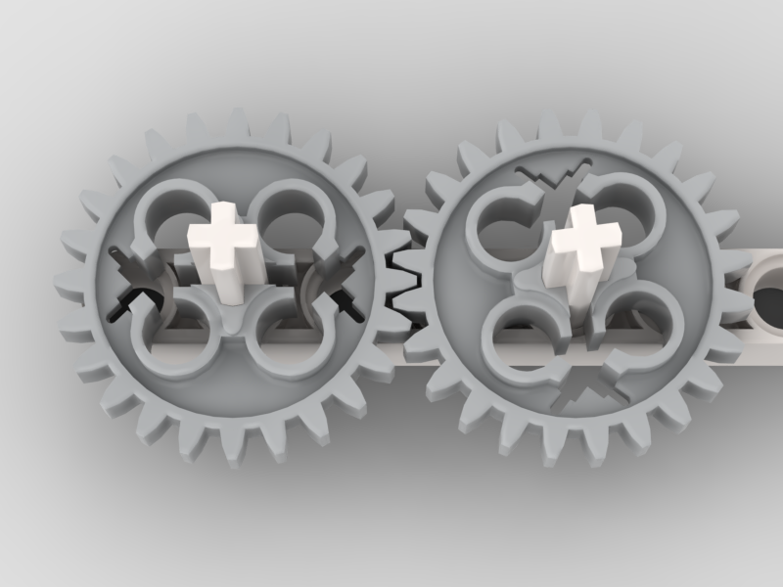
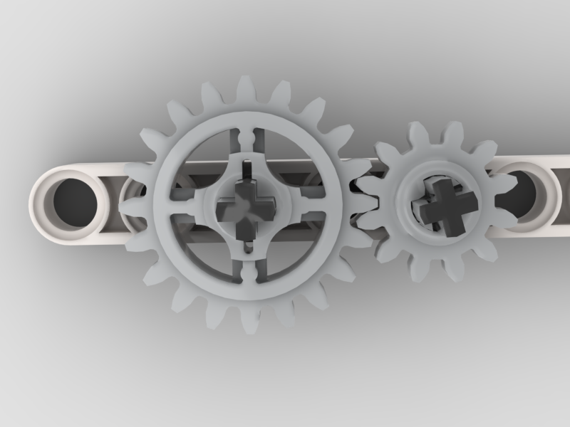
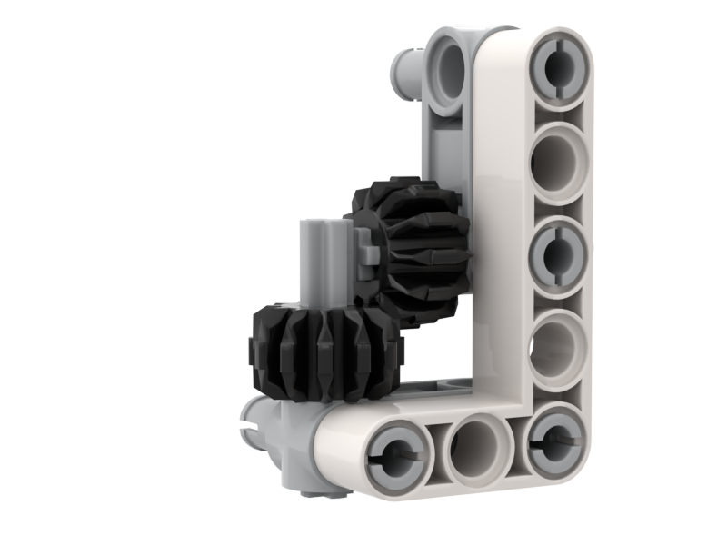
Gear Purposes
Change direction (clockwise / counter-clockwise). Cars with gasoline engines need to use gears if they want to drive in reverse. We can easily reverse our Lego motors, so we don’t normally need to use gears to reverse the direction.
Change gear ratio. Make the output stronger or faster as needed.
Change orientation. If you have an axle that is pointing one way, but you need it to point a different way, gears can make that happen

Slide 5
Gear Ratio
We know that when we have a small gear turning a big gear, we increase power, but decrease speed
Or, when we have a big gear that is turning a small gear, we increase speed, but decrease power
We need to decide how much power (or speed) our attachment will need
Since we probably need to change the output direction (from “up” to either “forward” or “left-right”), we may as well also adjust the gear ratio at the same time

Slide 6
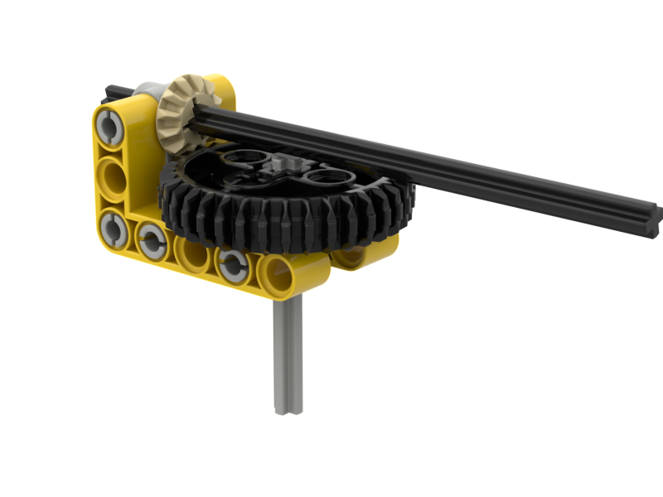
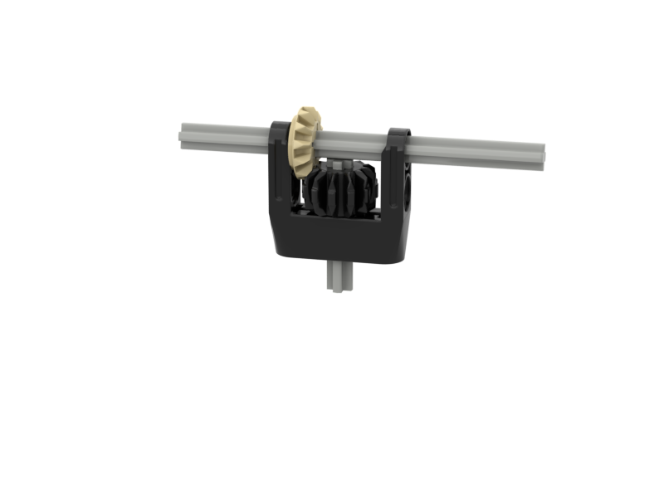
Right Angle Gears
We have two ways that we normally get our gears at right angles
Two L’s and two H’s
Right Angle Piece
Even though the one on the right looks simpler (5 pieces instead of 8), the one on the left is very easy to build and has a lot more useful options

Slide 7
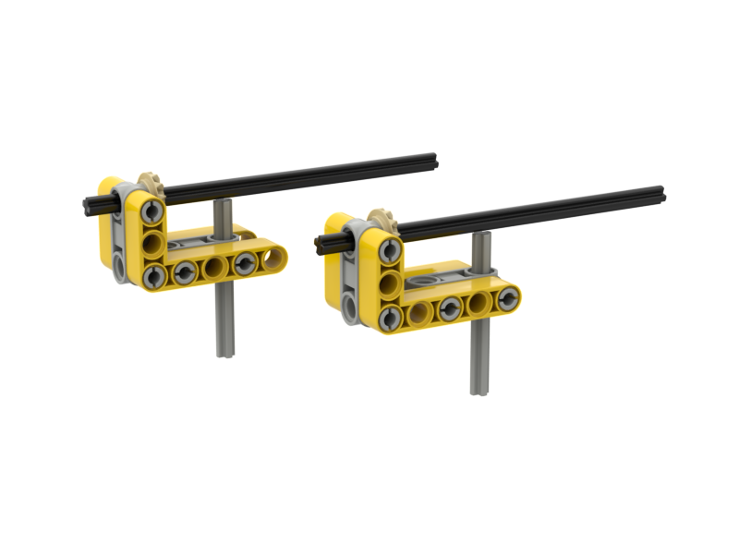
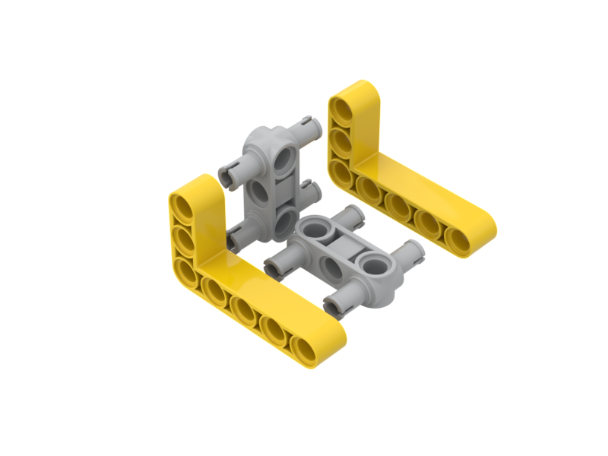
Two L’s and Two H’s
This is all there is to it. Note that the bottom H as shown here can be installed two different ways. Either way will work, but they will give you different options for the gears you can use.
Pos 1
Pos 2

Slide 8
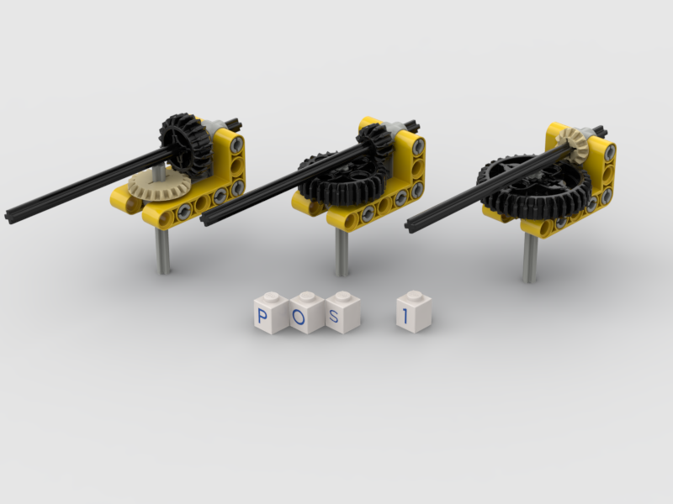
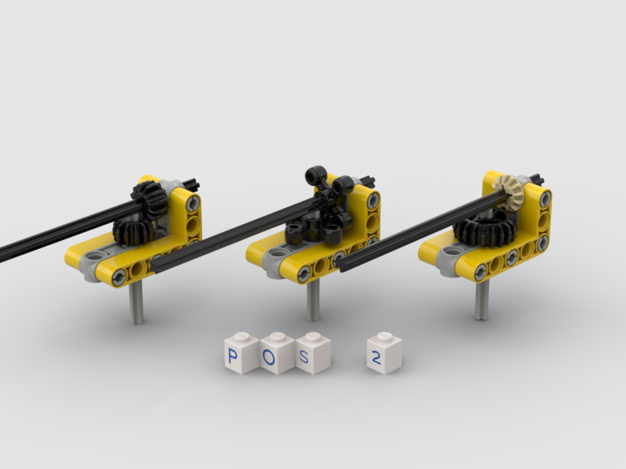
Pos 1 and Pos 2 Options
If I had to choose a favorite, I would pick Pos 1, but I do like the middle option on Pos 2. Those are called “Club Gears” and they are very strong and will never slip. If you have a problem with gears slipping, club gears may be able to help. Also note that the third option in Pos 1 may have a hard time fitting in some attachments.

Slide 9
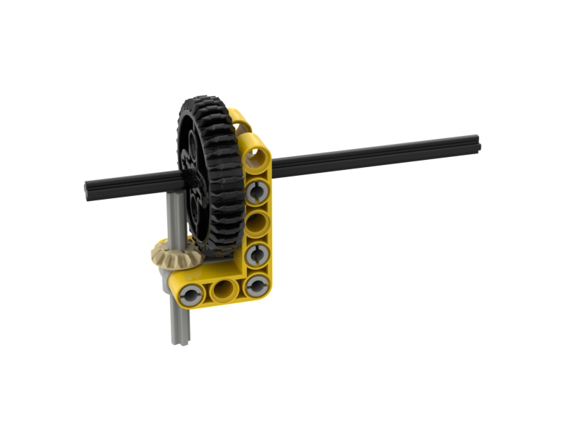
Two L’s and Two H’s can also be rotated
Do you need a very small gear driving a very large gear? Here’s how you do it. Again, you can use Pos 1 or Pos 2.

Slide 10
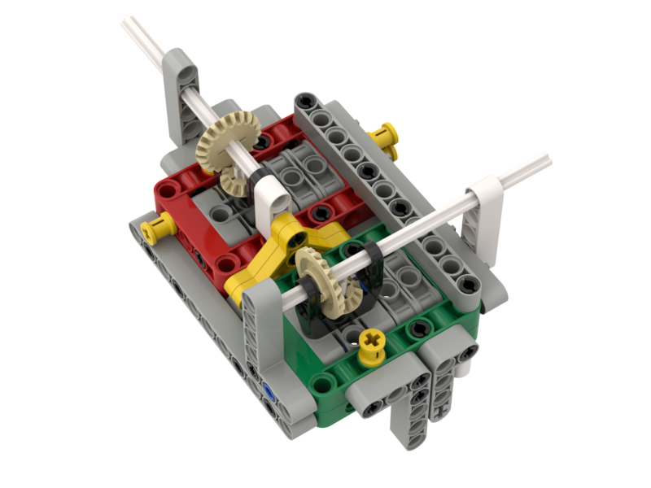
What’s Next
Make your decision on what direction you want your axle(s) to point, and what gears you want to use
If you are using Two L’s and Two H’s, decide if you want Pos 1 or Pos 2 (see next slide).
Pos 1
Pos 2
Right Angle Piece Attachment

Slide 11
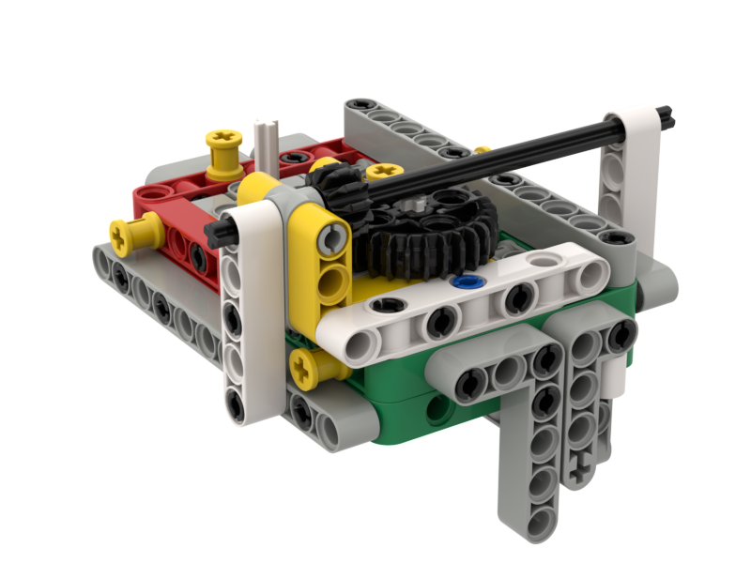
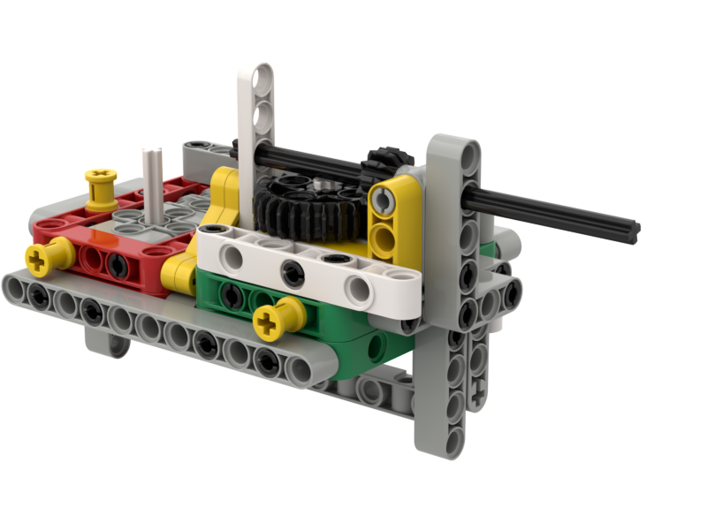
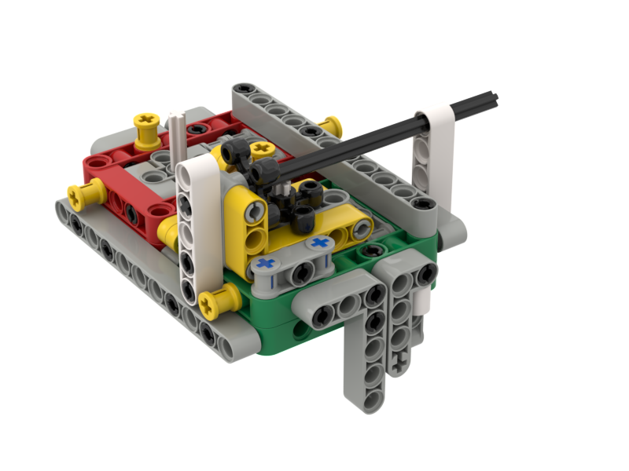
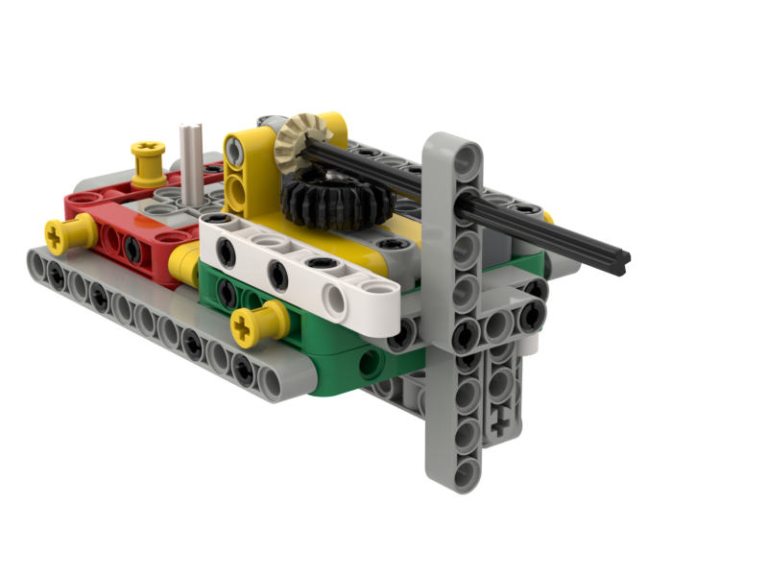
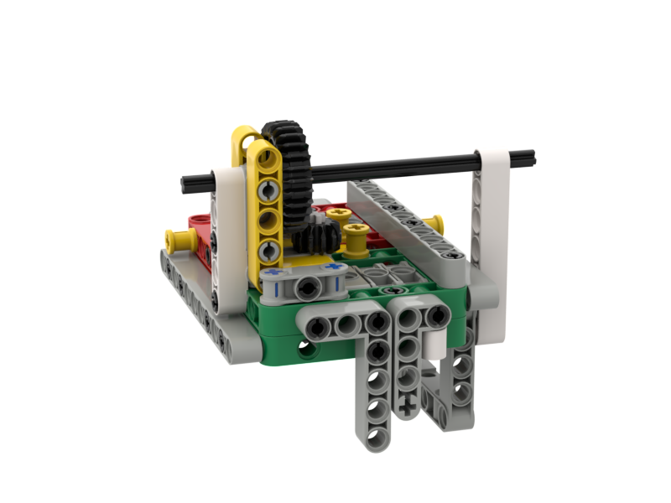
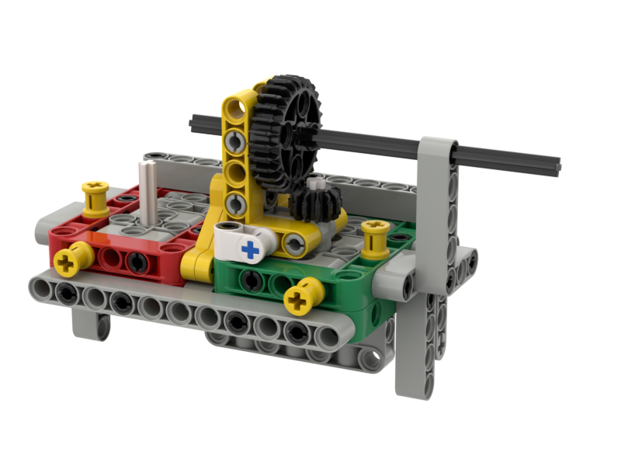
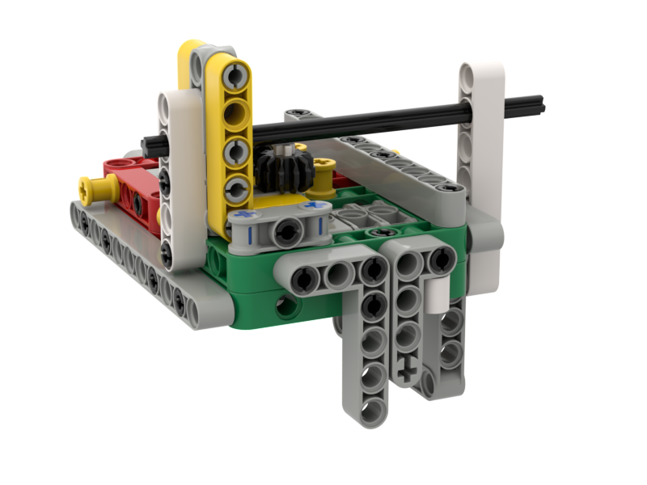
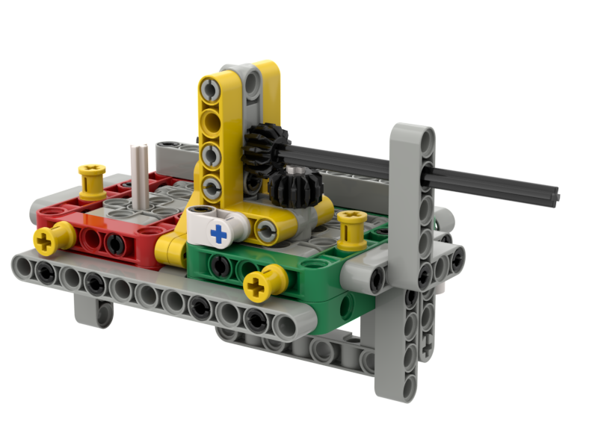
The purple text below each example is the file name for the build instructions
Large side down
Forward
Pos 1
2L2H #1 Large Side Down Forward Pos 1
Large side down
Left-Right
Pos 1
2L2H #2 Large Side Down Left-Right Pos 1
Large side down
Forward
Pos 2
2L2H #3 Large Side Down Forward Pos 2
Large side down
Left-Right
Pos 2
2L2H #4 Large Side Down Left-Right Pos 2
Small side down
Forward
Pos 1
2L2H #5 Small Side Down Forward Pos 1
Small side down
Left-Right
Pos 1
2L2H #6 Small Side Down Left-Right Pos 1
Small side down
Forward
Pos 2
2L2H #7 Small Side Down Forward Pos 2
Small side down
Left-Right
Pos 2
2L2H #8 Small Side Down Left-Right Pos 2

